Slide 1
The BIRCH Algorithm

Slide 2
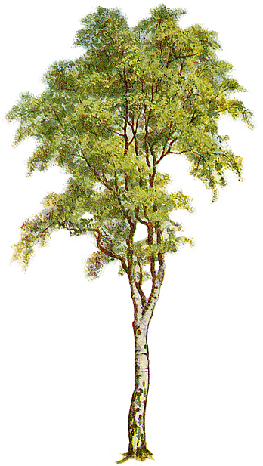
1. BIRCH – the definition
Balanced
Iterative
Reducing and
Clustering using
Hierarchies

Slide 3
1. BIRCH – the definition
An unsupervised data mining algorithm used to perform hierarchical clustering over particularly large data-sets.

Slide 4
2. Data Clustering – problems
Data-set too large to fit in main memory.
I/O operations cost the most (seek times on disk are orders of a magnitude higher than RAM access times).
BIRCH offers I/O cost linear in the size of the dataset.

Slide 5
3. BIRCH advantages
It is local in that each clustering decision is made without scanning all data points and currently existing clusters.
It exploits the observation that data space is not usually uniformly occupied and not every data point is equally important.
It makes full use of available memory to derive the finest possible sub-clusters while minimizing I/O costs.
It is also an incremental method that does not require the whole dataset in advance.

Slide 6
4. BIRCH concepts and terminology
Hierarchical clustering

Slide 7
4. BIRCH concepts and terminology
Hierarchical clustering
  The algorithm starts with single point clusters
  (every point in a database is a cluster).
  Then it groups the closest points into separate clusters, and continues, until only one cluster remains.
  The computation of the clusters is done with a help of distance matrix (O(n²) large) and O(n²) time.

Slide 8
4. BIRCH concepts and terminology
Clustering Feature
The BIRCH algorithm builds a clustering feature tree (CF tree) while scanning the data set.
Each entry in the CF tree represents a cluster of objects and is characterized by a triple (N, LS, SS).

Slide 9
4. BIRCH concepts and terminology
Clustering Feature
Given N d-dimensional data points in a cluster,
X_{i} (i = 1, 2, 3, … , N)
CF vector of the cluster is defined as a triple CF = (N,LS,SS):
N - number of data points in the cluster
LS - linear sum of the N data points
SS - square sum of the N data points

Slide 10
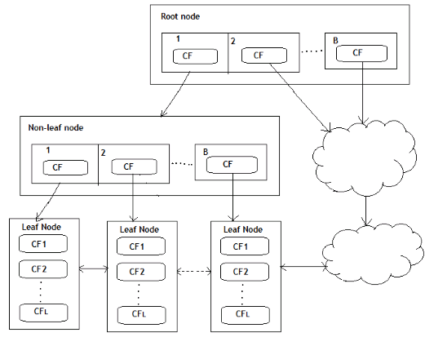
How does it work?
The BIRCH algorithm uses a tree structure to create a cluster. It is generally called the Clustering Feature Tree (CF Tree).
Each node of this tree is composed of several Clustering features (CF).
Clustering Feature tree structure is similar to the balanced B+ tree
Each node including leaf nodes has several CFs, and the CFs of internal nodes have pointers to child nodes, and all leaf nodes are linked by a doubly linked list.

Slide 11
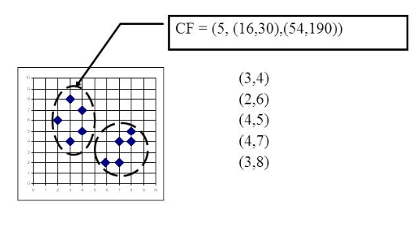
For example, as shown in the following figure, in a CF of a node in the CF Tree, there are the following 5 samples (3,4), (2,6), (4,5), (4,7), ( 3,8). Then it corresponds to

Slide 12
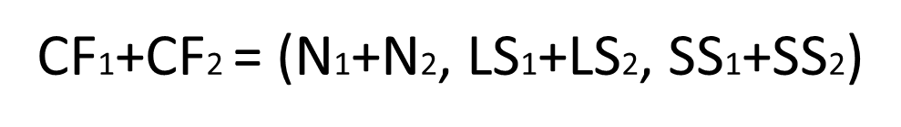
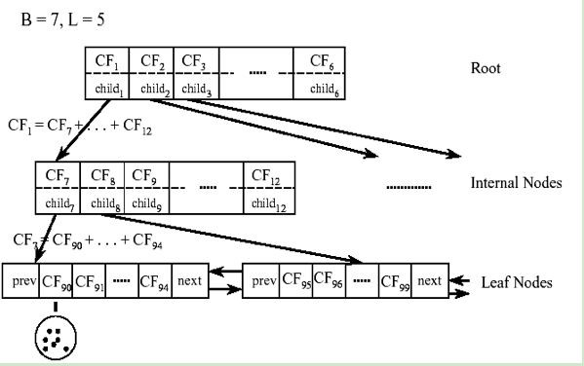
CF has a very good property. It satisfies the linear relationship, that is:
This property is also well understood by definition. If you put this property on the CF Tree, that is to say, in the CF Tree, for each CF node in the parent node, its (N, LS, SS) triplet value is equal to the CF node pointed to The sum of the triples of all child nodes.

Slide 13
As can be seen from the above figure, the value of the triplet of CF1 of the root node can be obtained by adding the values ​​of the 6 child nodes (CF7-CF12) that it points to. In this way, we can be very efficient when updating the CF Tree.
For CF Tree, we generally have several important parameters,
The first parameter is the maximum CF number B of each internal node,
The second parameter is the maximum CF number L of each leaf node,
The third parameter is for the sample points in a CF in the leaf node. It is the maximum sample radius threshold T of each CF in the leaf node. That is to say, all sample points in this CF must be in the radius In a hyper-sphere less than T.
For the CF Tree in the above figure, B = 7 and L = 5 are defined, which means that the internal node has a maximum of 7 CFs, and the leaf node has a maximum of 5 CFs.

Slide 14
5. Conclusion
Pros
Birch performs faster than existing algorithms
(CLARANS and KMEANS) on large datasets.
Scans whole data only once.
Handles outliers better.
Superior to other algorithms in stability and scalability.

Slide 15
5. Conclusion
Cons
Since each node in a CF tree can hold only a limited number of entries due to the size,
a CF tree node doesn’t always correspond to what a user may consider a nature cluster.
Moreover, if the clusters are not spherical in shape,
it doesn’t perform well because it uses the notion of radius or diameter to control the boundary of a cluster.

